Slide 1



Data Platform Training Day ColumnStore Indexes: A new way to handle DW Workloads 6/4/2020

Slide 2
300K+MEMBERS WORLDWIDE
279 LOCAL
GROUPS
5 GLOBAL NEWSLETTERS
22VIRTUAL GROUPS
4000 ATTENDEES
AT PASS SUMMIT
100+LOCAL EVENTS

Slide 3
Speaker
Gonzalo Bissio
SQL Engineering Team at Ernst & Young
MCSA 2012 - 2014- 2016 Database administration / MCSE: Data Management and Analytics.
Flamante y orgulloso papá de Pedrito.
Amo el mundo DBA tanto como al
Club Independiente y a Rocky Balboa.
Blog: sqlserverrules.wordpress.com
Email: gonzalobissio@Hotmail.com
Twitter: @Gbissio

Slide 4

Registrarse para una membresía gratuita y asociarse al grupo Local SQL Argentina:
pass.org
Sqlargentina.pass.org
https://www.facebook.com/groups/SQLArgentina/
@sqlargentina
https://www.linkedin.com/groups/3664741
https://www.youtube.com/channel/UCGadNDwP8nAVfQwqoeYHw
#SQLHelp

Slide 5
Agenda:
Introduction to Columstores
Differences between B-Tree indexes and Columnstores
Limitations using Columnstores
Maintaining Columnstores
Extended events for columnstore

Slide 6
Introduction to Columnstores:
The columnstore represents a new storage format of storing relational data. It stores data as columns instead of
rows as shown in the picture below representing a relational table with 5 columns. Note, though the data is
stored as columns, you can still query the table to fetch the row with all its columns but it is more expensive to
rowstore where all the columns are stored together.
C1
C2
C3
C4
Highly compressed – common data type
Columns often have repeating data – which makes it easy to compress
More data fits in memory
Efficient IO from disk to memory
Each column can be accessed independently
Fetch only columns that are needed
Can dramatically decrease I/O

Slide 7
Introduction to Columnstores:
Segments
Row group
A group of rows compressed into the Columnstore format at the same time
Max number of rows in a group is 1,048,576
Segment
A column of data within a rowgroup
Segments are compressed and LOB stored
Segment (LOB) is unit of transfer between disk and memory
C1
C2
C3
C4
C5
C6
Row
group

Slide 8
Introduction to Columnstores:
DeltaStore:
A b-tree staging area
Rows accumulate until there are enough to be compressed into the columnstore format
1,048,576 rows
A background process compresses these rows to columnstore compression
Allows for efficient access to “warm” data
Improves compression of the columnstore index
Will not see batch mode execution from row store storage

Slide 9
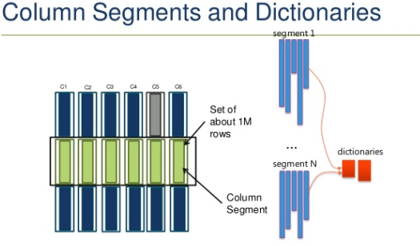
Introduction to Columnstores
Index Dictionary:
All data types that store character data ([n]char and [nvarchar), as well as binary and varbinary, when used in a
columnstore index, use dictionaries for their internal storage. For other columns, dictionaries may also be used –
especially if they use only a small set of distinct values. Using a dictionary means that SQL Server creates a list of
all values that are used, and assigns each value a unique number. For a column with colors, the dictionary would,
for instance, contain a list of the value pairs (Black, 1); (Red, 2); (Green, 3); (Mauve, 4); etc.
This dictionary is stored as a separate entity, related to but not part of the storage area used for the table data.

Slide 10
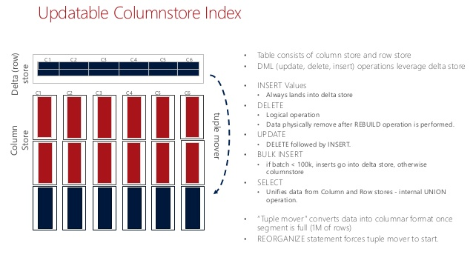
Introduction to columnstores
Tuple mover:

Slide 11
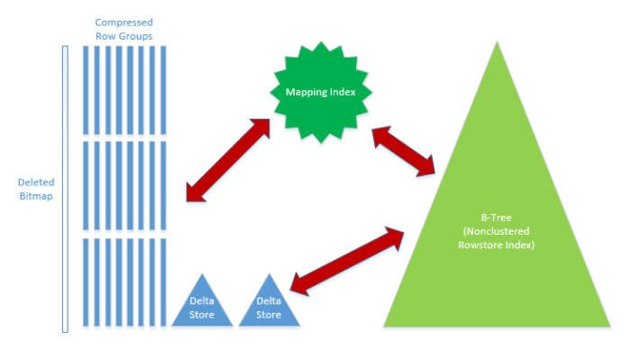
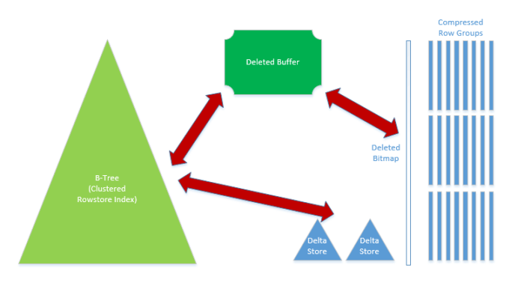
Introduction to columnstores
Clustered columnstore + Non clustered row store
Clustered row store + Non clustered columnstore

Slide 12
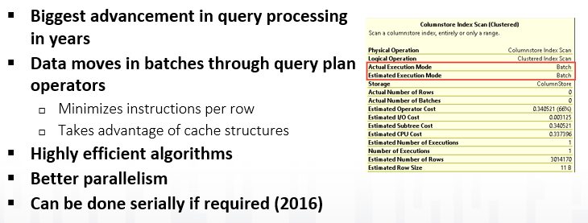
Introduction to Columnstores
Batch Processing:

Slide 13
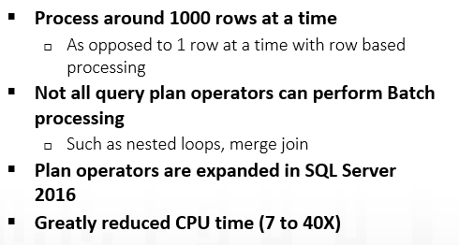
Introduction to Columnstores
Batch Processing:

Slide 14
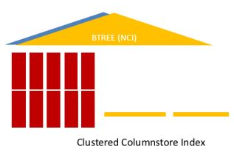
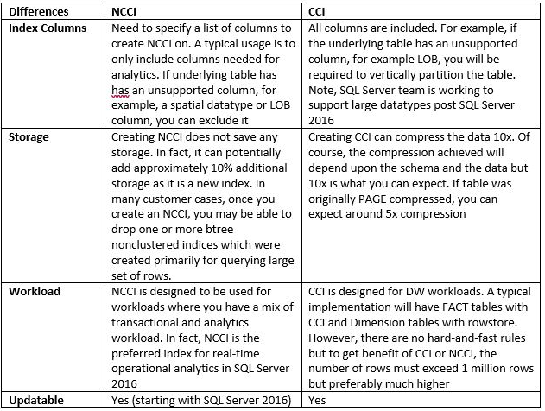
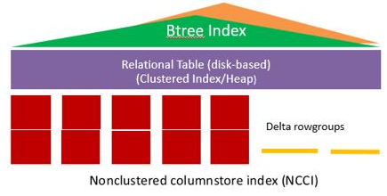
Introduction to Columnstores
Clustered Vs Non clustered columnstores:

Slide 15
Introduction to columnstores
Improvements in SQL 2016:
A rowstore table can have one updateable nonclustered columnstore index. Previously, the nonclustered columnstore index was read-only. The nonclustered columnstore index definition supports using a filtered condition
Support for primary keys and foreign keys by using a btree index to enforce these constraints on a clustered columnstore index.
Columnstore indexes have a compression delay option that minimizes the impact of the transactional workload on real-time operational analytics.
Columnstore indexes support read committed snapshot isolation level (RCSI) and snapshot isolation (SI).
Columnstore supports index defragmentation by removing deleted rows without the need to explicitly rebuild the index
Columnstore indexes can be access on an AlwaysOn readable secondary replica and also they can be created with in-memory tables as well.
To improve performance, SQL Server computes the aggregate functions MIN, MAX, SUM, COUNT, AVG during table scans when the data type uses no more than 8 bytes, and is not of a string type also windows functions .
Predicate pushdown speeds up queries that compare strings of type [v]char or n[v]char. This applies to the common comparison operators and includes operators such as LIKE that use bitmap filters
Single-threaded queries running under MAXDOP 1 or with a serial query plan execute in batch mode. Previously-only multi-threaded queries ran with batch execution

Slide 16
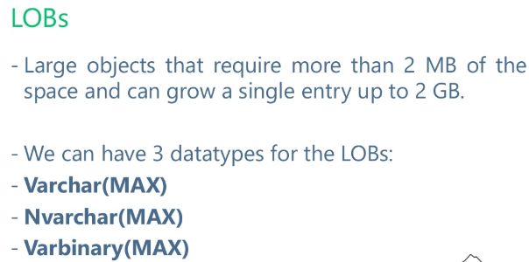
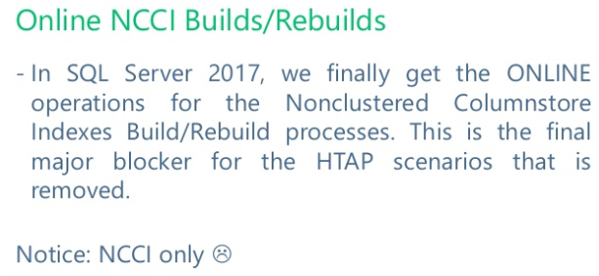
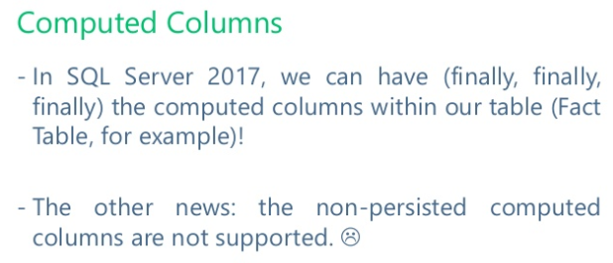
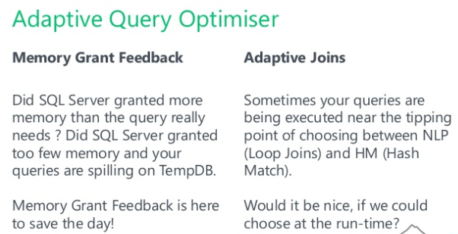
Introduction to columnstores
Improvements in SQL 2017:

Slide 17
Introduction to Columnstores
Improvements in SQL 2019:
sp_estimate_data_compression_savings supports columnstores
(COLUMNSTORE and COLUMNSTOREARCHIVE options)
Clustered columnstore build and rebuild
DBCC CLONEDATABASE update the statistics for columnstore indexes
IMPORTANT THING!!
IF YOU ENABLE IN MEMORY TEMPDB FEATURE YOU WILL NOT BE ABLE TO CREATE
COLUMNSTORES INDEXES IN TEMPORAL TABLES OR EXECUTE
SP_ESTIMATE_DATA_COMPRESSION_ SAVINGS STORED PROCEDURE!

Slide 18
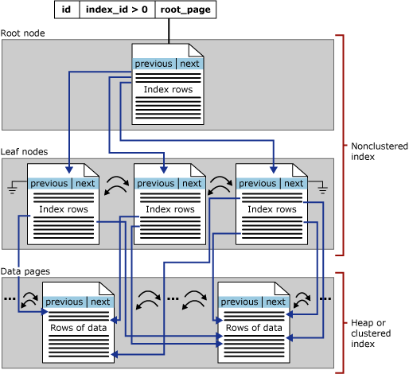
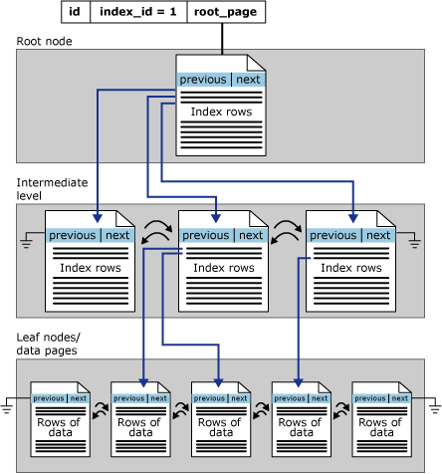
Differences between B-Tree indexes and Columnstores
B-tree:
Columnstores:
Non clustered:
Clustered:

Slide 19
DEMO:
How to implement CCI and NCCI
2) Selecting Segments, Row groups, Delta stores, Dictionaries
with CISL script library
SQL 2019 New Features
Performance gain
Compatibility issue, Memory and dictionary pressure

Slide 20

Questions

Slide 21


Slide 22


Slide 23
Limitations using columnstores
Limitations:
Data types not supported:
ntext, text, and image
rowversion (and timestamp)
sql_variant
CLR types (hierarchyid and spatial types)
xml
uniqueidentifier (Applies to SQL Server 2012)
Features not supported:
Page and row compression
Replication
Filestream
Resumable index is not supported with columnstores

Slide 24
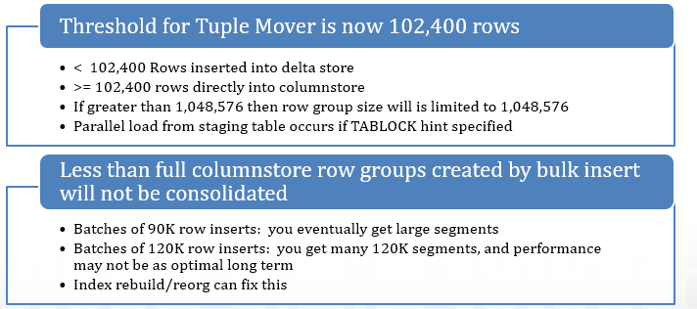
Limitations using columnstores
Bulk Insert operations:

Slide 25
DEMO:
Parallel Insert, Bulk Insert with small batch size and DML operations

Slide 26
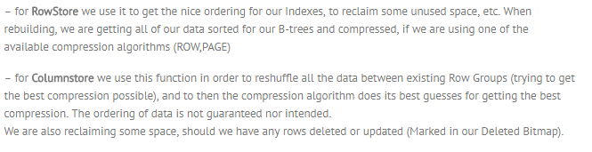
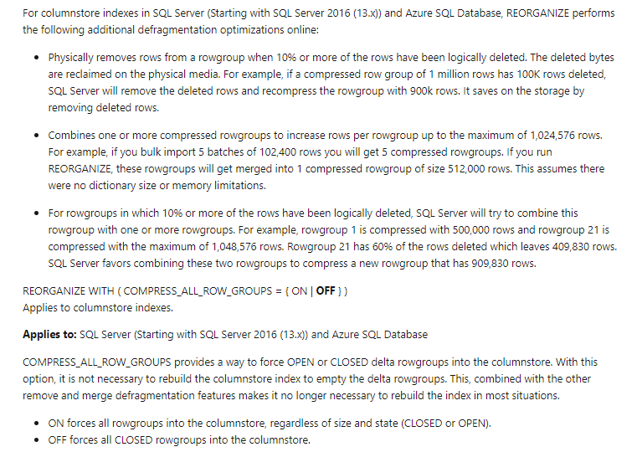
Maintaining Columnstores
Rebuild
Reorganize:

Slide 27
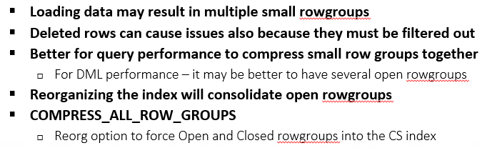
Maintaining Columnstores
Fragmentation:

Slide 28
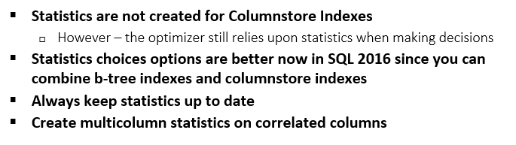
Maintaining Columnstores
Stats:

Slide 29
Maintaining Columnstores
Maintenance solutions:
As of now Ola hallengrean’s solution doesn’t support columnstores
Other options are:
Nick Neugebauer’s solution -> Link
SQL Tiger team AdaptiveIndexDefrag index solution -> Link

Slide 30
DEMOS:
1- Columnstore Maintenance -> How to Rebuild/Reorganize

Slide 31
Extended events and Waits for columnstore
Events that you can use -> Link
Column_store_index_low_memory -> “Storage Engine detected a low memory condition and the rowgroup size was reduced.”
Column_store_index_build_process_segment -> “A rowgroup was processed. Indicates the number of rows
in the rowgroup and the reason it was trimmed if any.”
Column_store_index_memory_estimation -> “Shows the memory estimation result during columnstore rowgroup build”
Wait Types -> Link

Slide 32
People to follow
Sunil Agarwal -> @S_u_n_e_e_l
Niko Neugebauer -> @nikoneugebauer -> www.nikoport.com
Joe Obbish -> Link
Reccomended pages:
Microsoft Customer stories -> Link

Slide 33
Final Questions

Slide 34


